Slide 1

Breast Cancer Classification
Statistical Learning Project
Alessia d’Addario Mat. 2086506
Alice Ronzoni Mat 2076675

Slide 2
Problem Presentation
 | Breast Tumor from Wisconsin University
DATASET
 | Find a model that correctly classifies breast tumor cancer given some features
GOAL

Slide 3
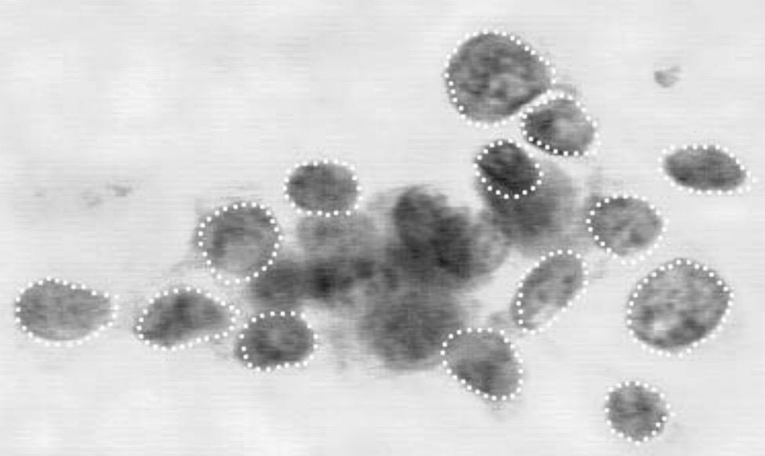
Features
ID
Diagnosis
Radius
Texture
Perimeter
Area
Smoothness
Compactness
Concavity
Concave_pts
Symmetry
Fractal_dim
Repeated
for:
mean
SE
worst

Slide 4
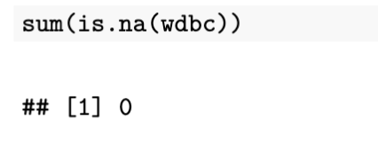
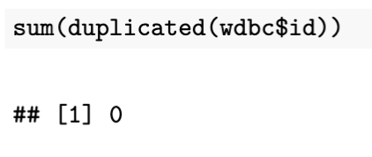
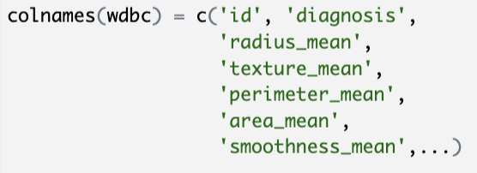
Clean and Filter Data
Check for missing values
Check for duplicate ID
Rename the columns

Slide 5
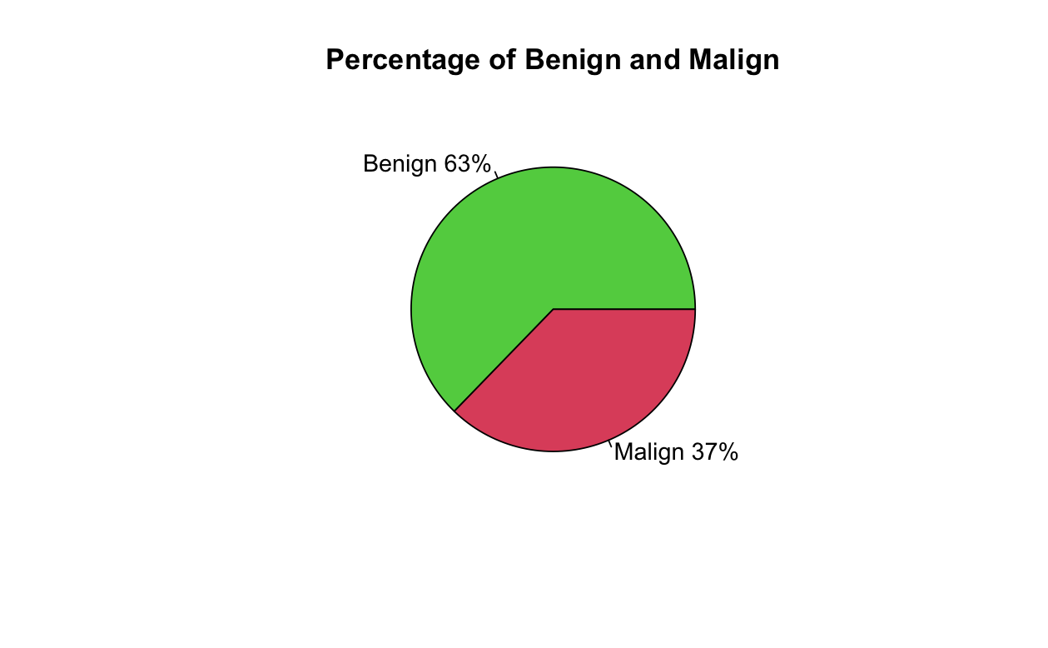
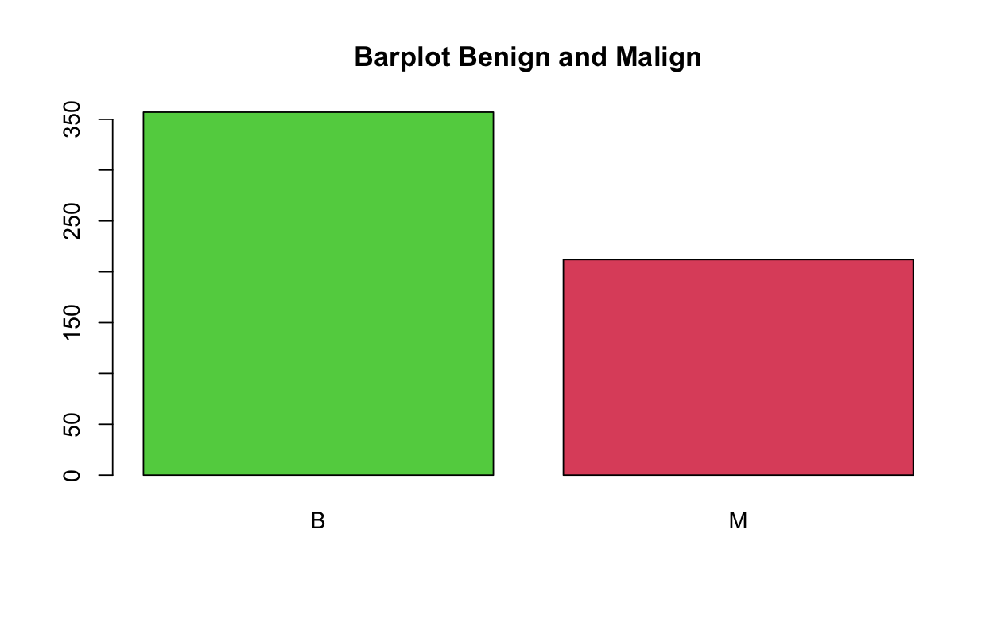
Data Exploration

Slide 6
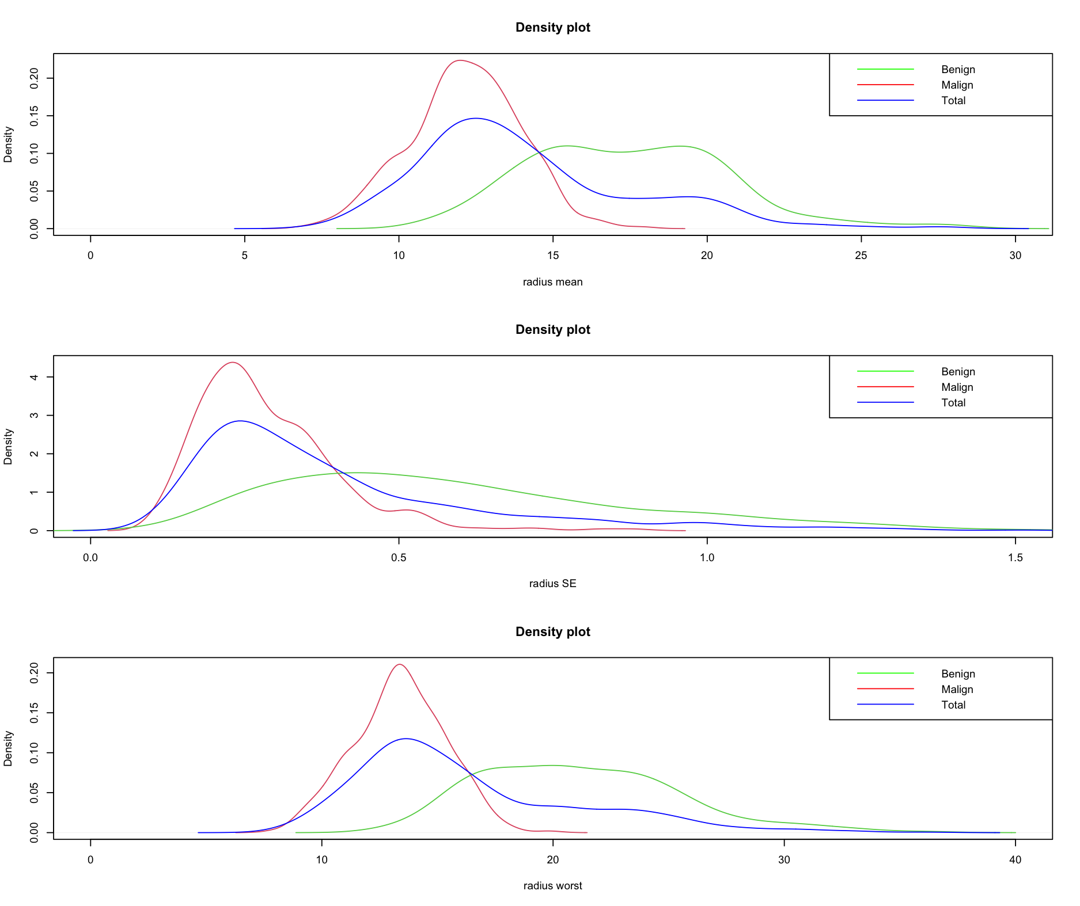
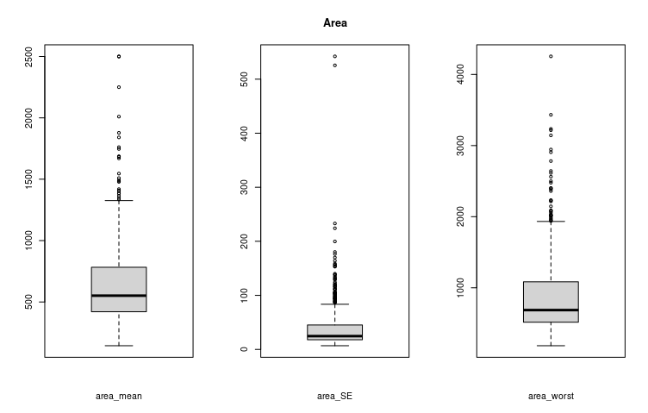
Data Exploration
We started by observing the plot produced by our features.
Here we report the ones obtain from the Area and Concavity values:

Slide 7
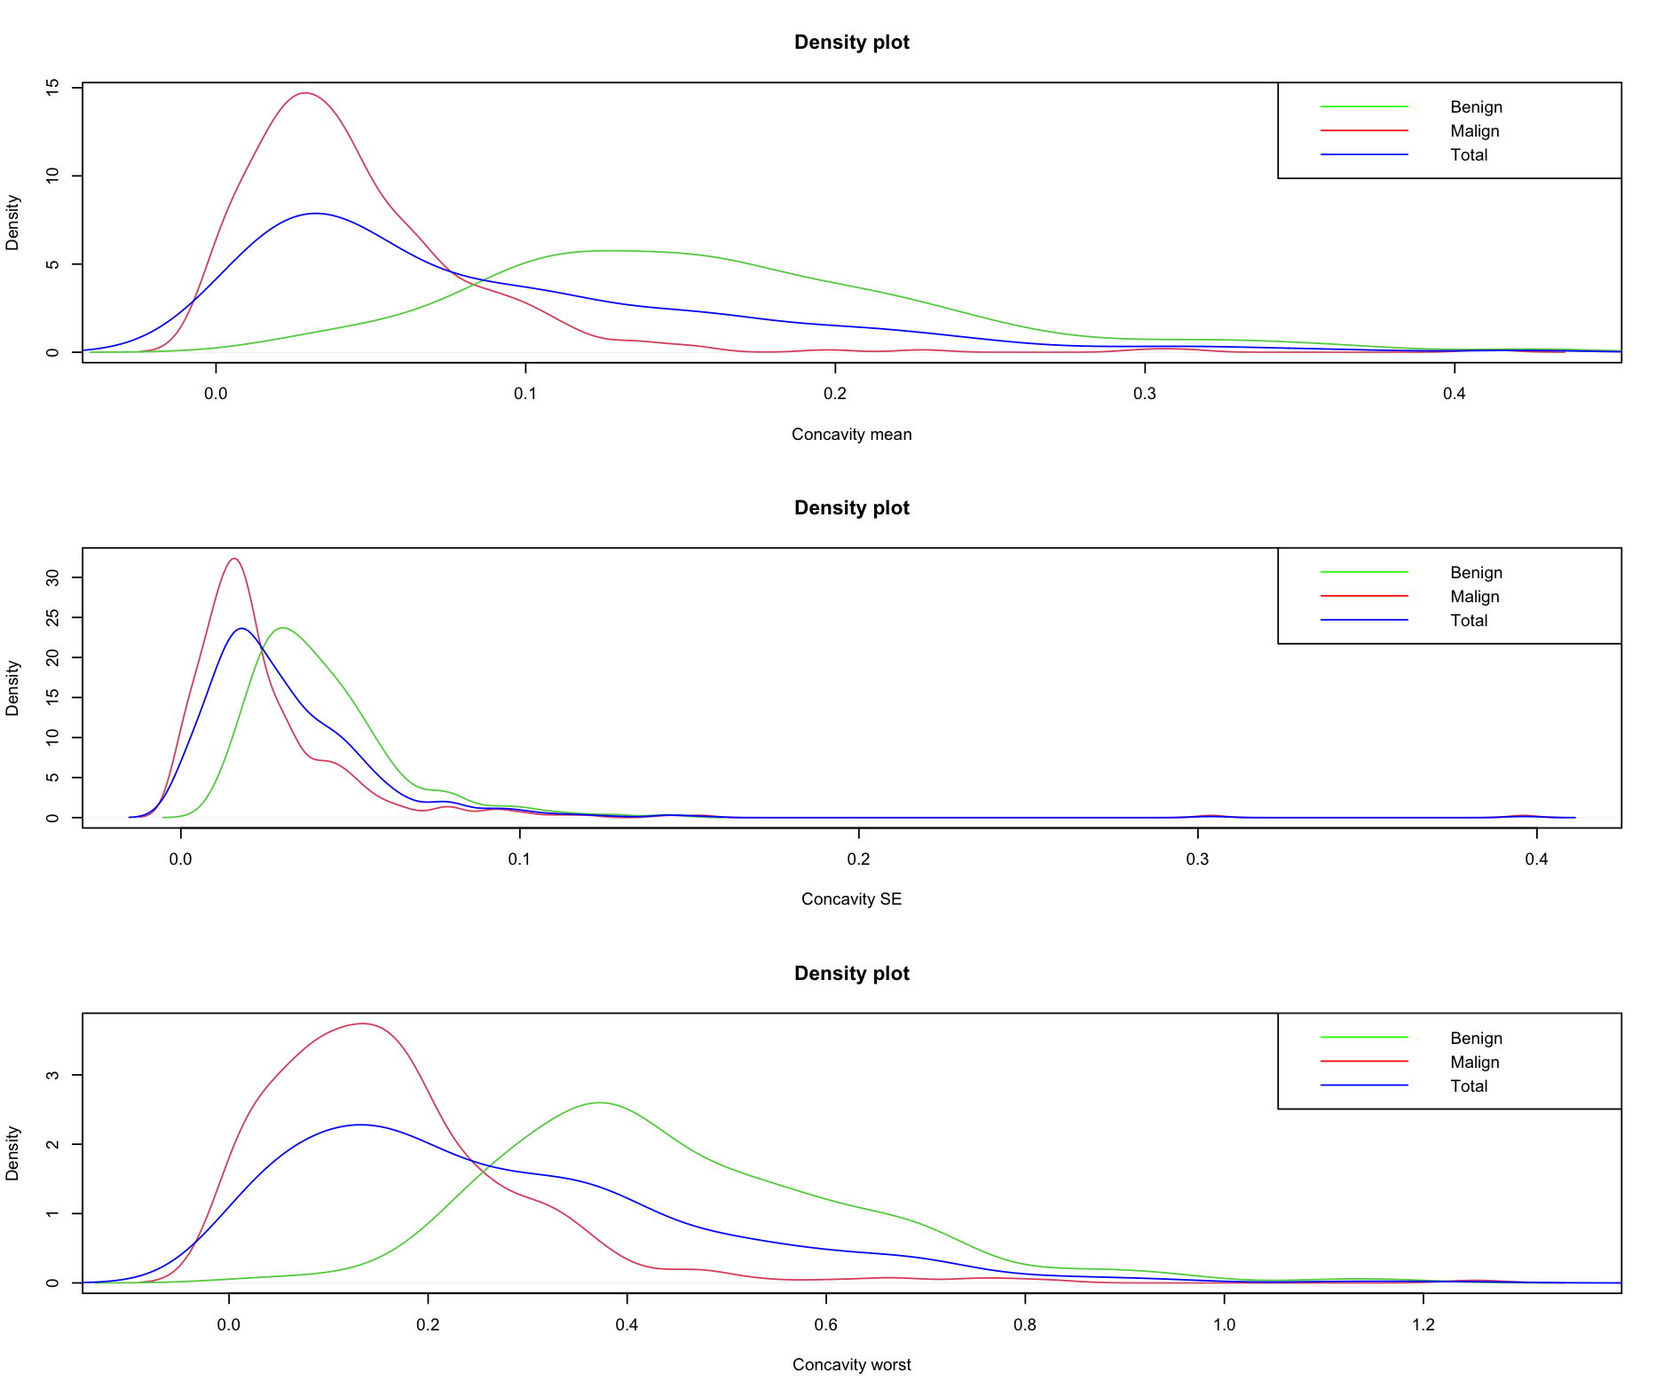
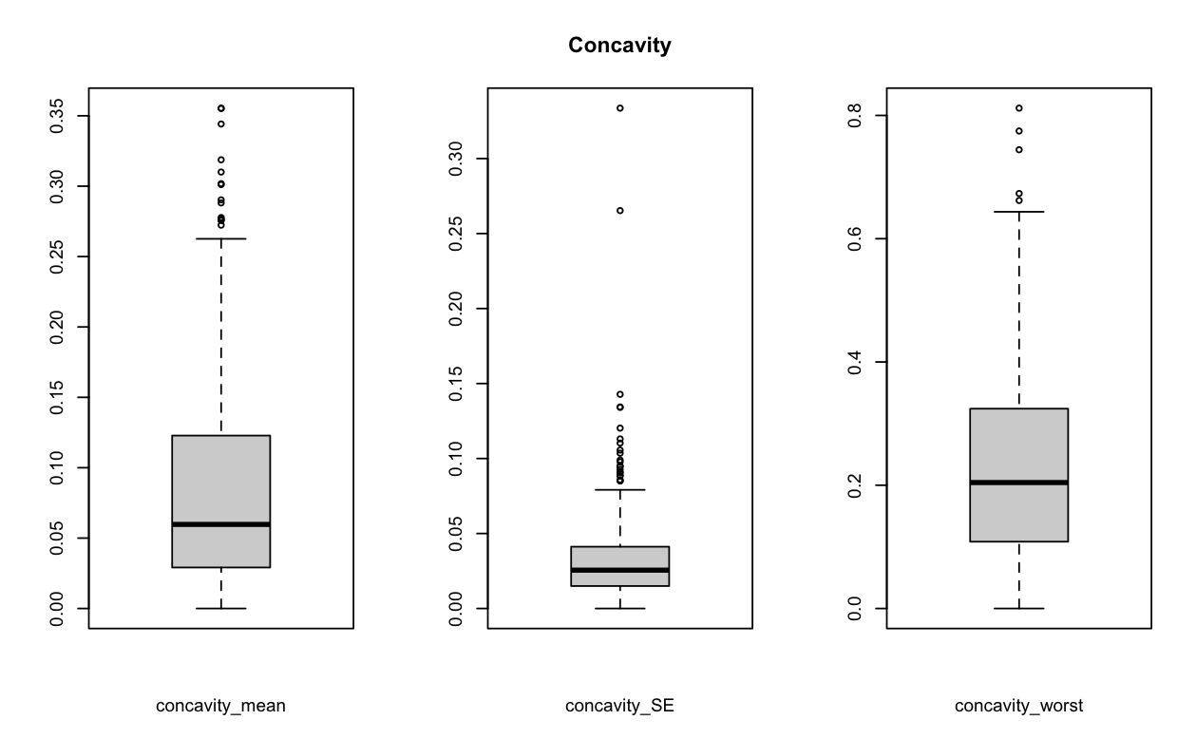
Data Exploration
Since the density plots don’t resemble a very good bell shape, before further explorations we checked for the normality of the data.

Slide 8
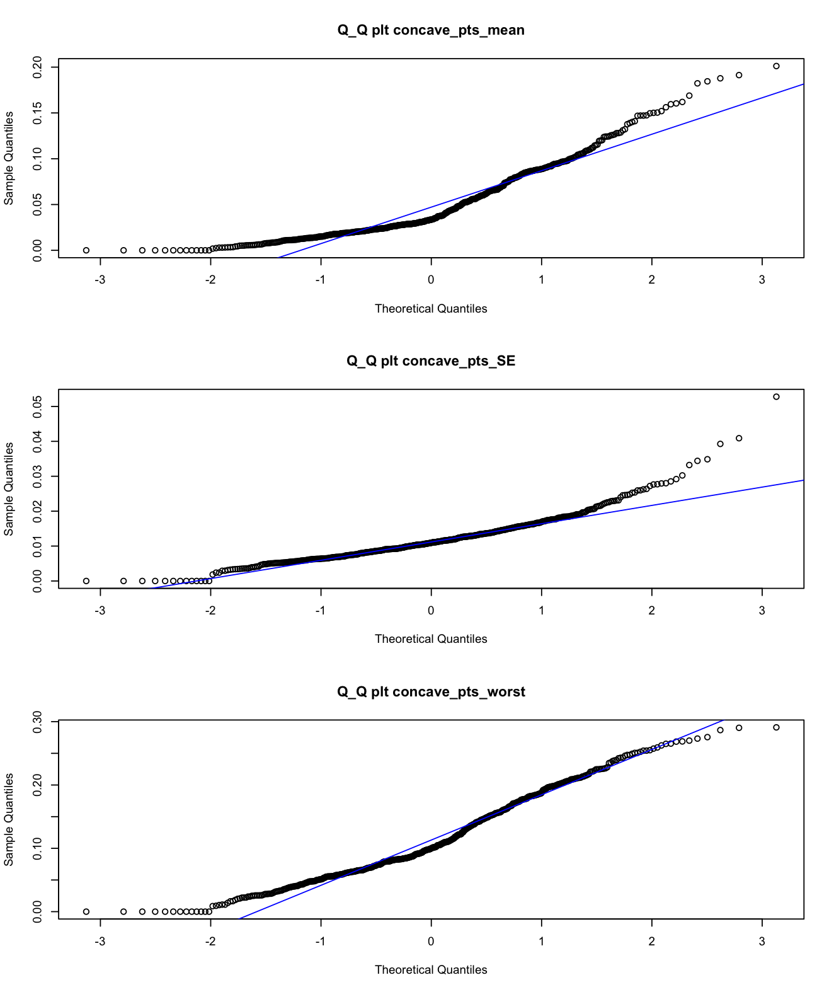
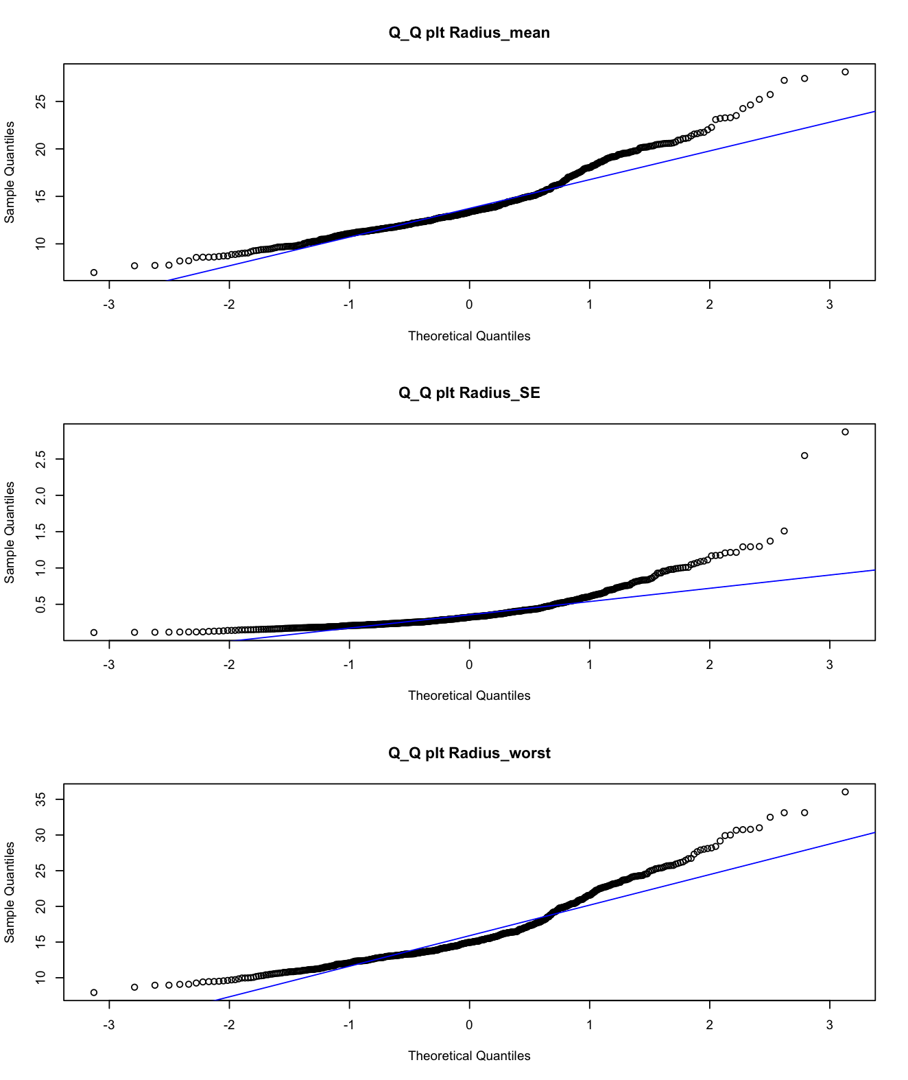
Data Exploration
As supposed our features lack of normality behaviour
For this reason we decided to apply a non linear transformation to the predictor :
log()

Slide 9
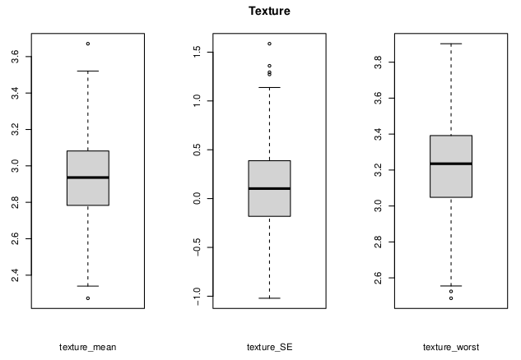
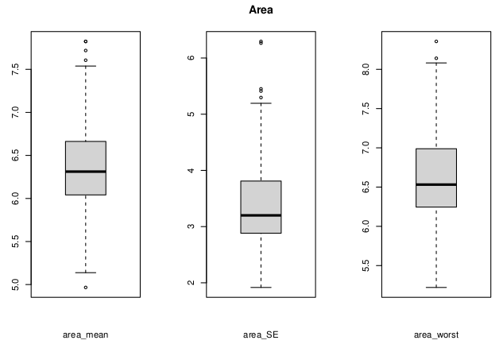

Slide 10
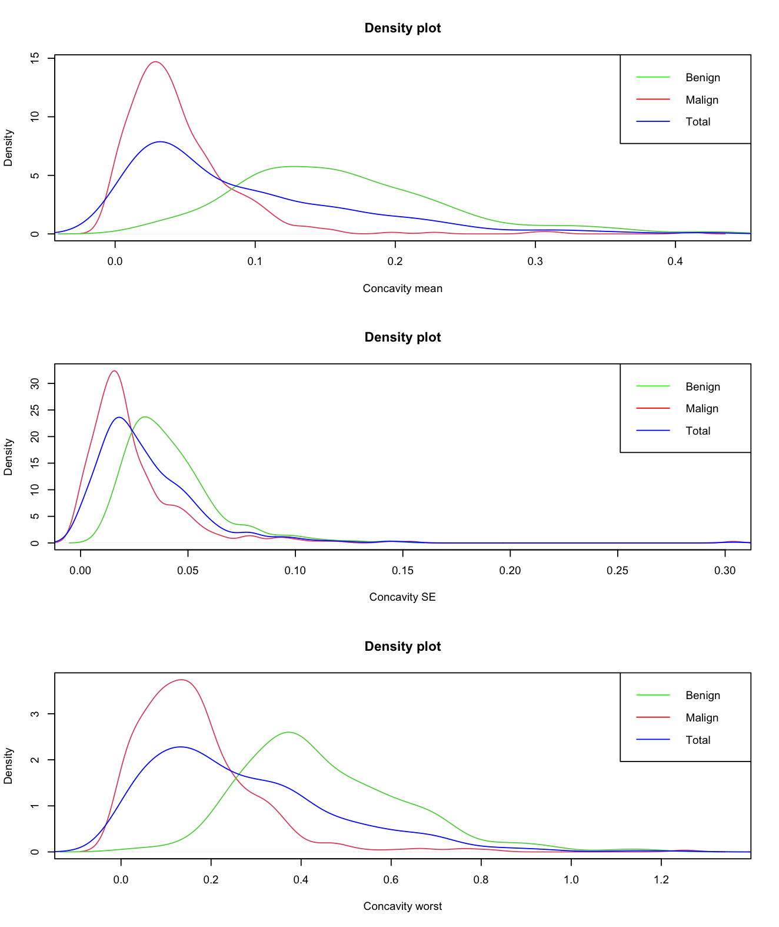
Data Exploration cnt

Slide 11
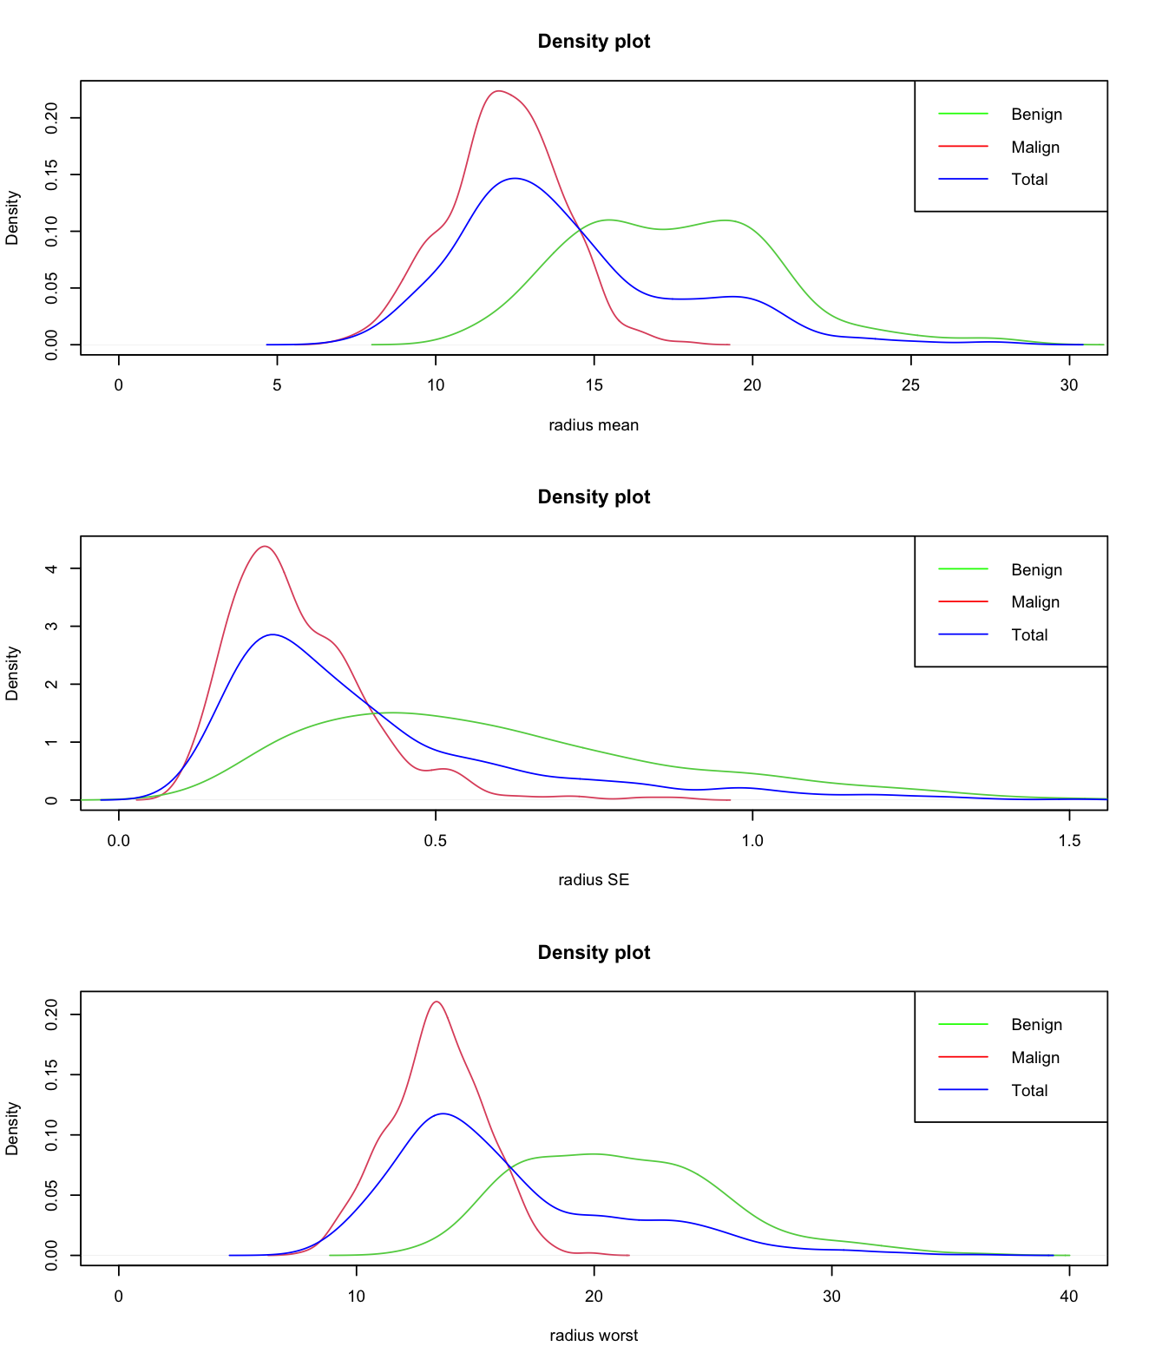

Slide 12
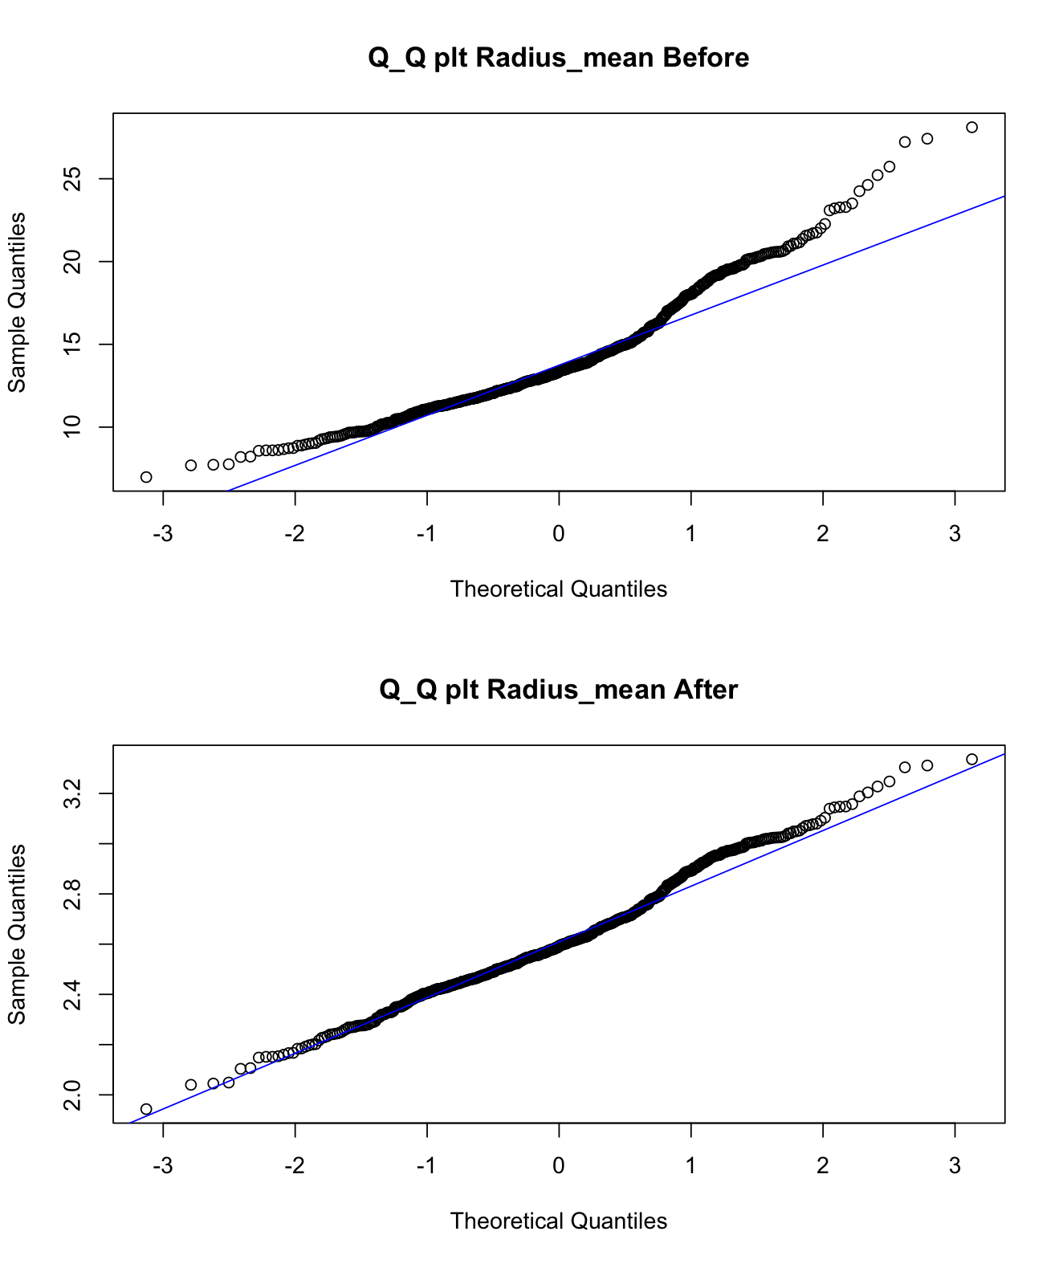
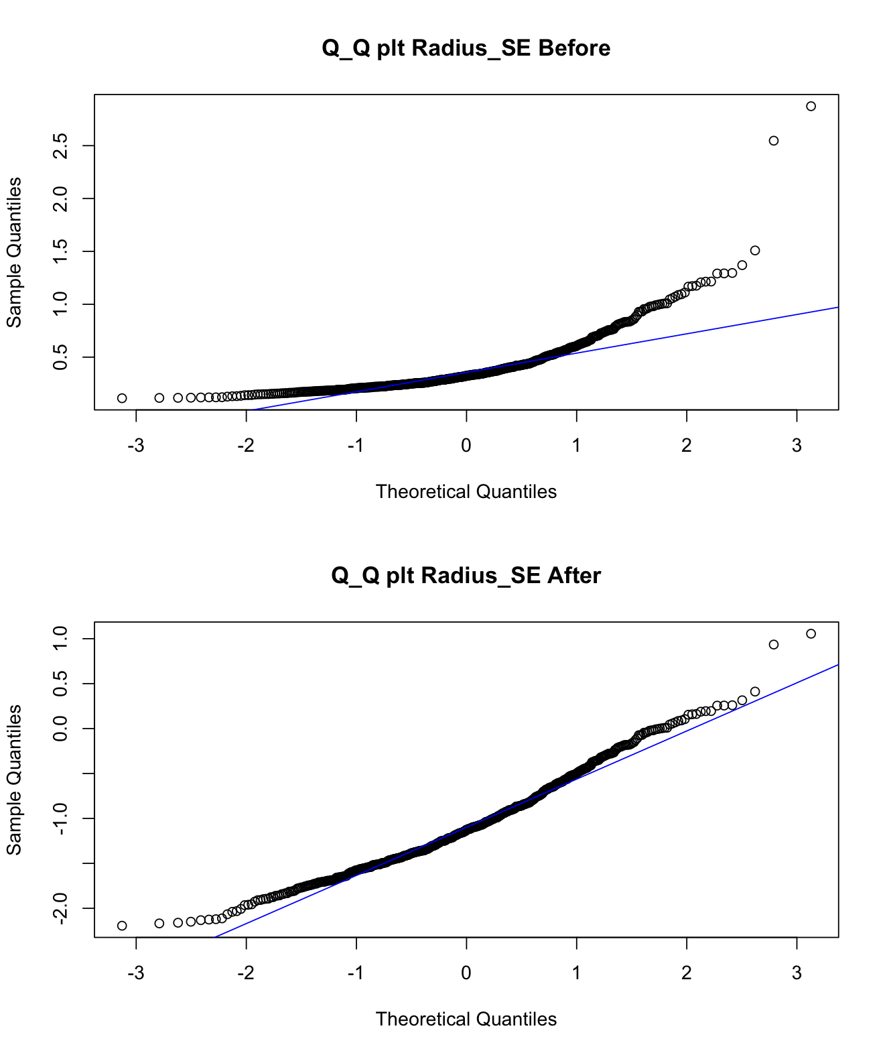
Let’s see the outcome of the transformation :

Slide 13
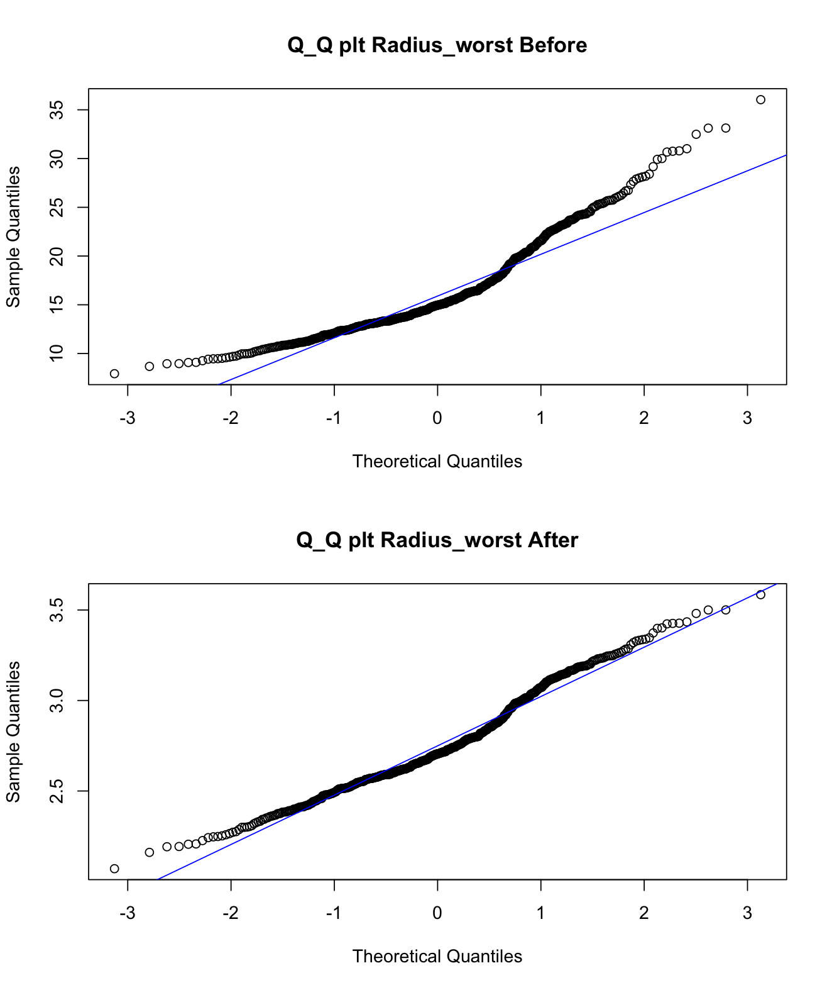
Trova un titolo sta di fatto che sono già a confronto

Slide 14
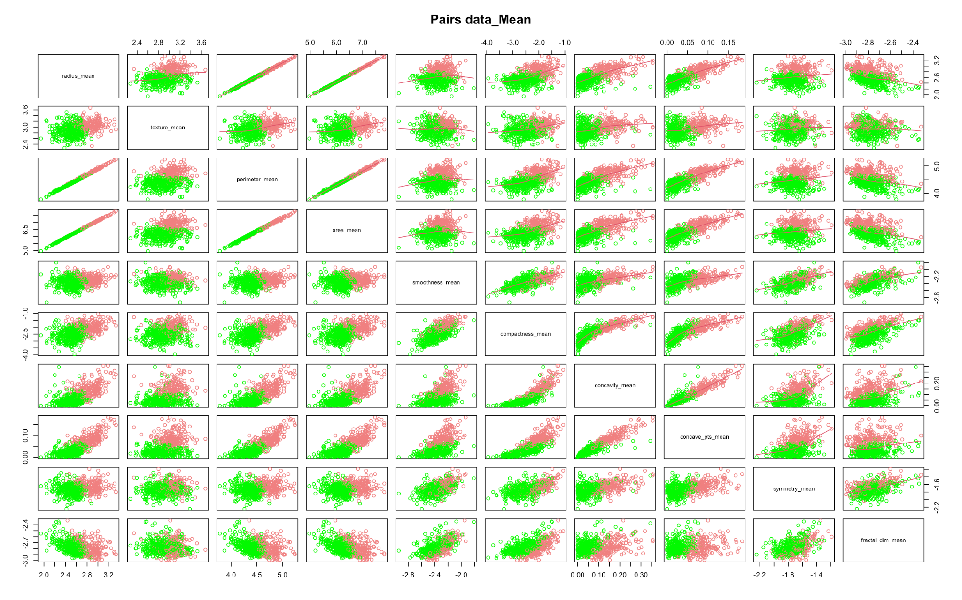
Pairs Plot
To visualize a pairwise comparison of the correlations between our variables we plotter the Pair Plot.
For simplicity we consider attributes referring to the same group.
Here we report the comparison between the mean values.

Slide 15
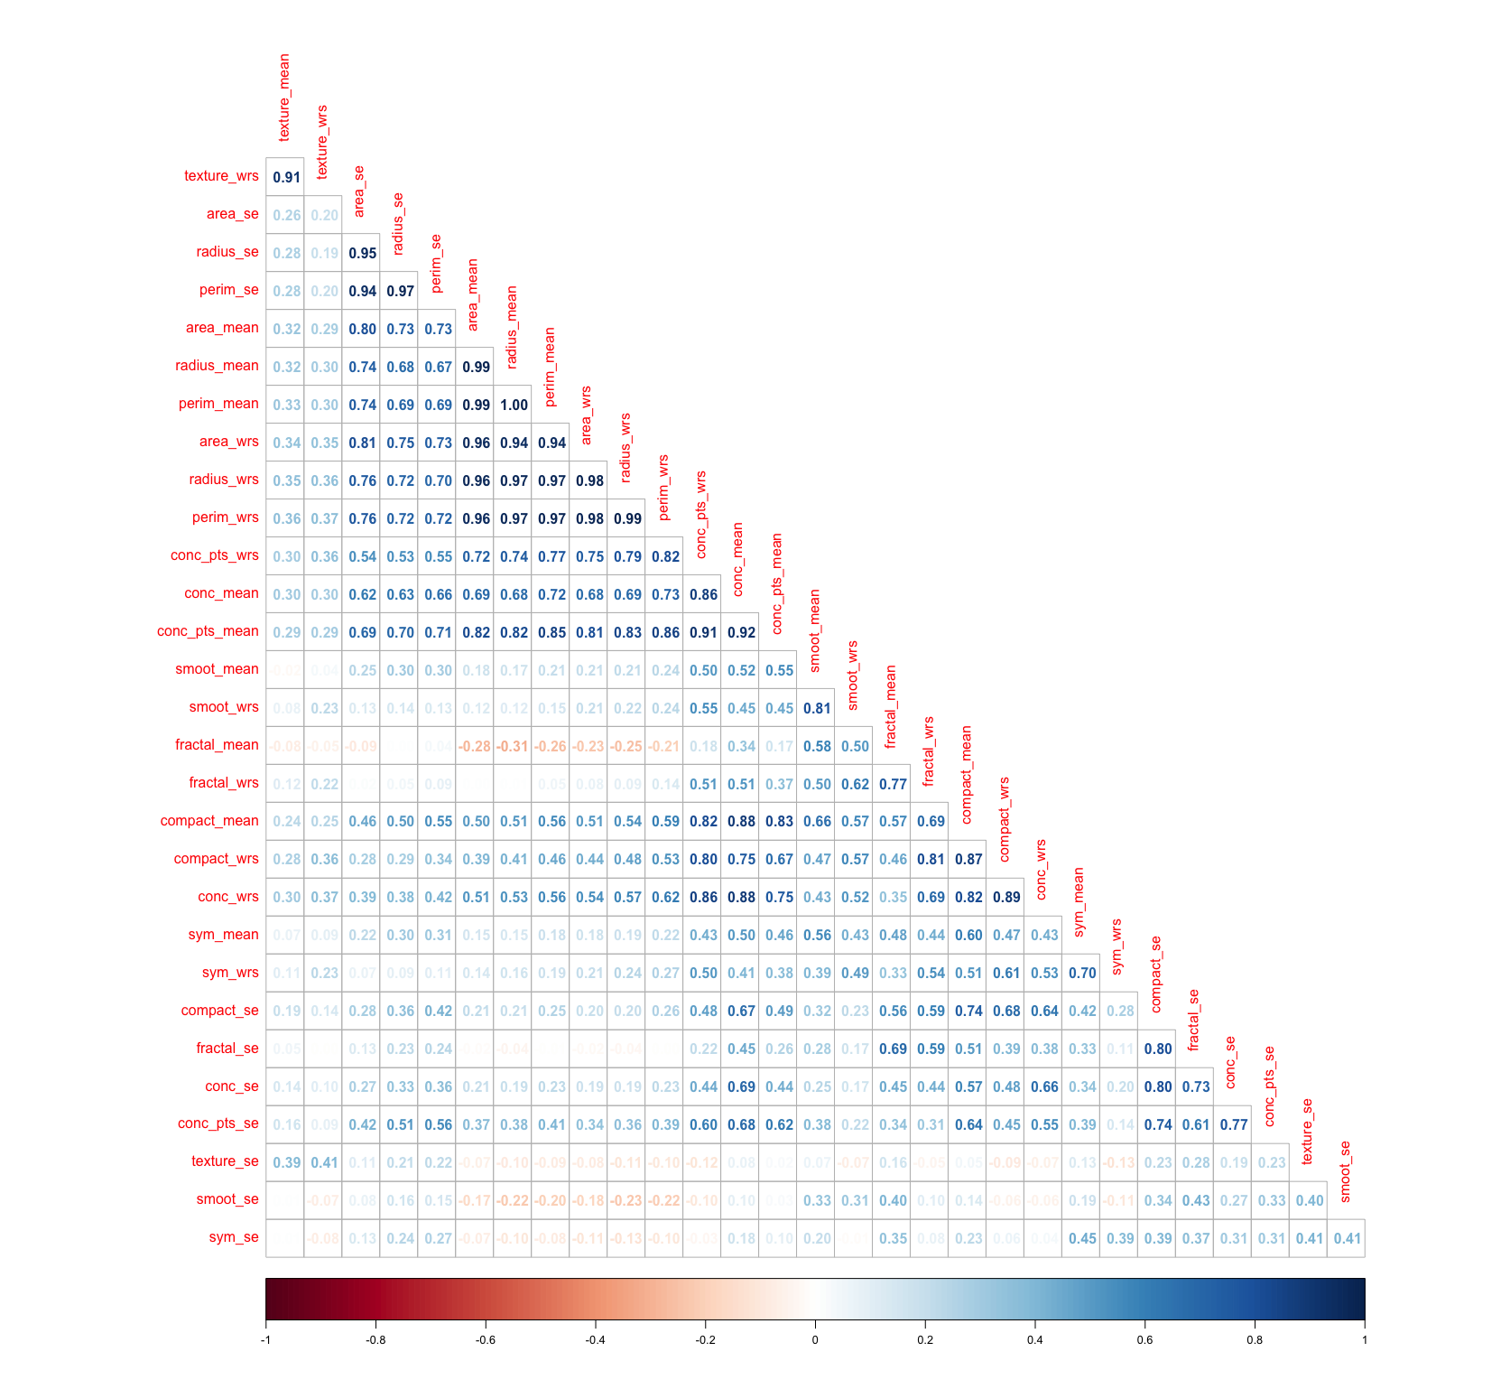
Correlation Matrix
Problem
And with the help of the covariance matrix, we were able to have numerical values of such correlation.
We noticed some high correlation values that could hide a collinearity problem.
We will need to take it in consideration during the model analysis.

Slide 16
Classification Models

Slide 17
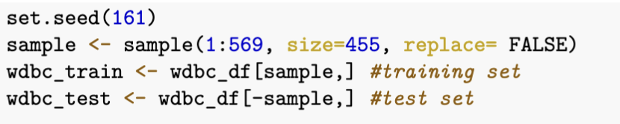
Train and Test Set
We decided to divide the dataset into two smaller subsets:
Train set (80%)
Test set (20%)

Slide 18
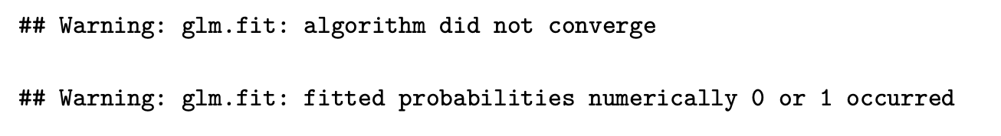
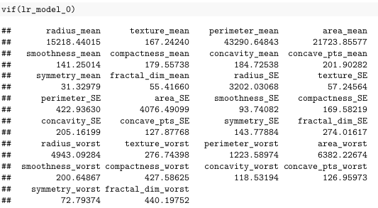
Logistic Regression as Classification
As first Model we used Logistic Regression.
To begin we tried using all the parameters, but we obtained two warning messages.
This lead us to look at the VIF of our model:

Slide 19
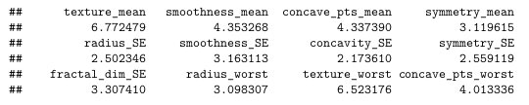
Logistic Regression as Classification
Result of the VIF function after applying it different times

Slide 20
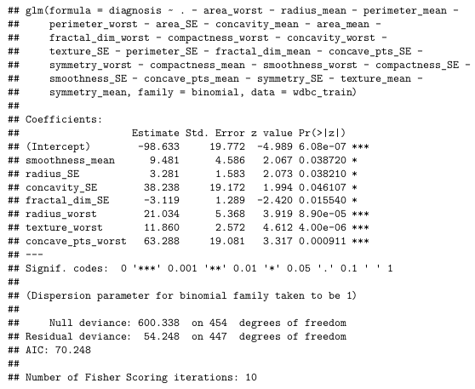
Result of the Backward selection
Starting with the model obtained after the application of the VIF method, we use the Backward Selection.
At the end our model contains
7 features:
smoothness_mean
radius_SE
concavity_SE
fractal_dim_SE
radius_worst
texture_worst
concave_pts_worst

Slide 21
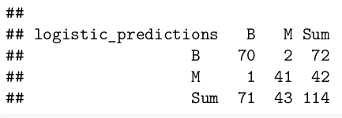
Confusion Matrix on Logistic Regression
Error | 0.02631579
Specificity | 0.9534884
Sensitivity | 0.9859155
Precision | 0.9722222

Slide 22
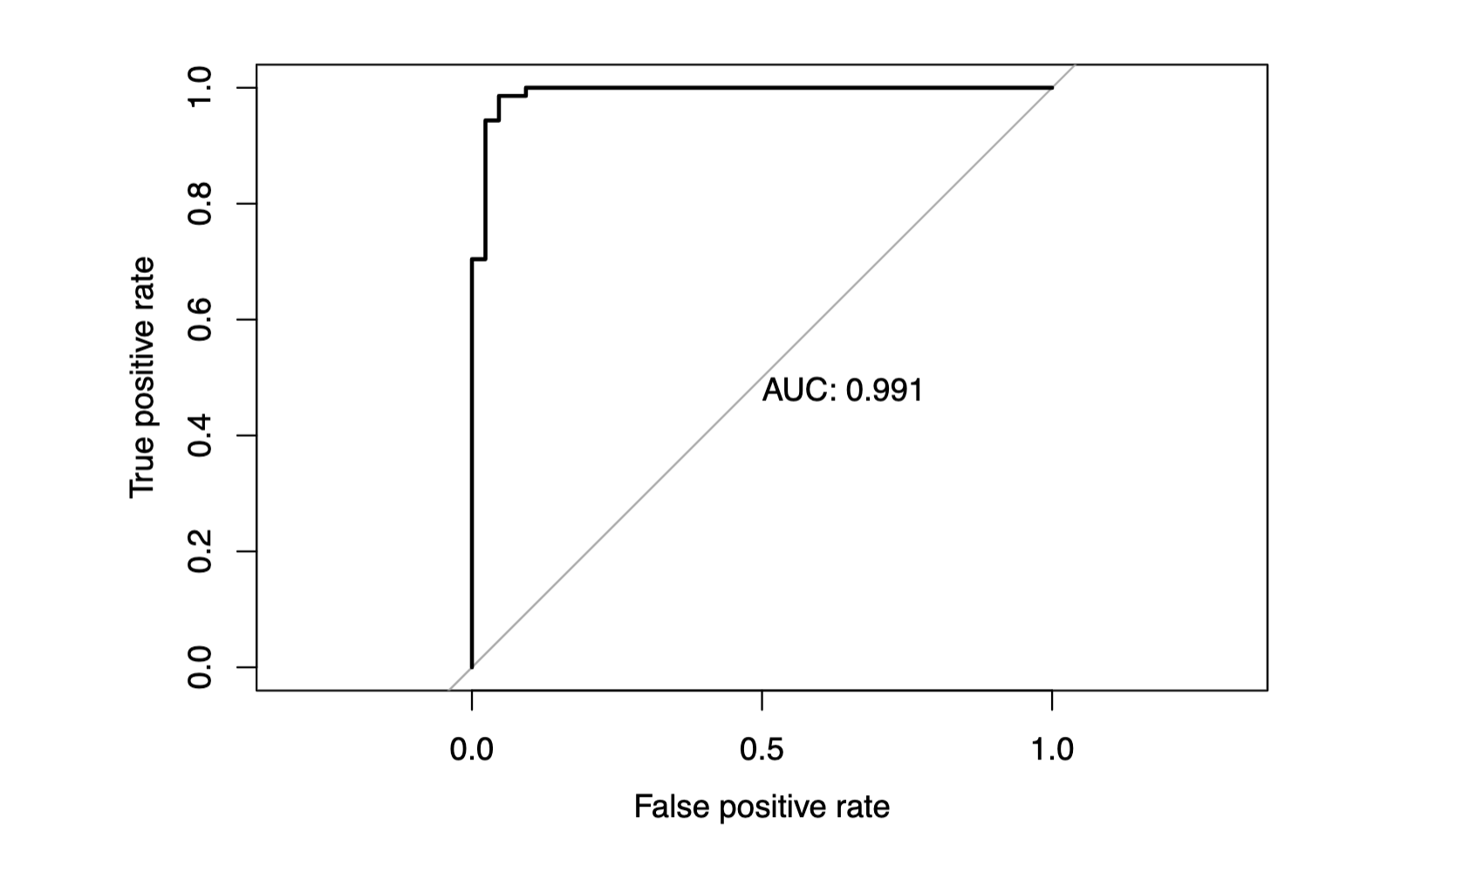
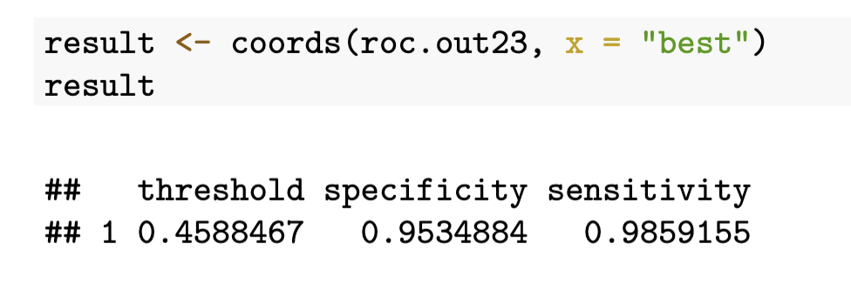
ROC Curve
We plotted the Roc curve that simultaneously display the True and False positive rates for all possible threshold
and we used the best one to do predictions

Slide 23
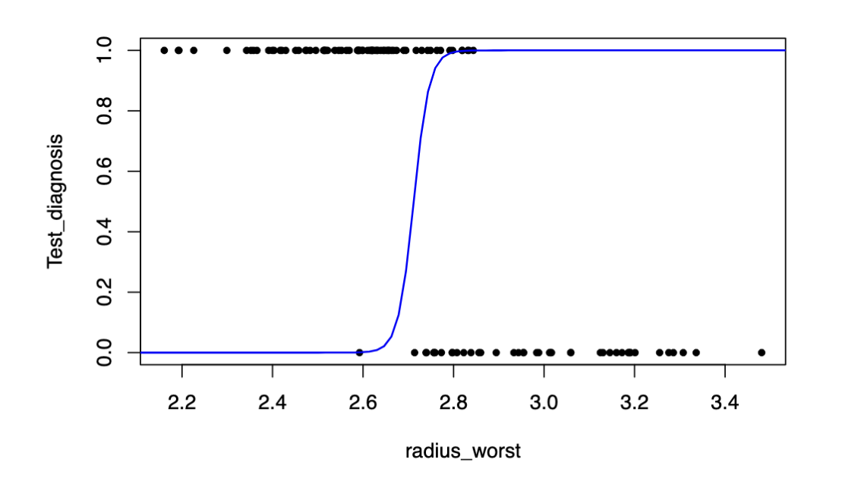
Logistic plot

Slide 24
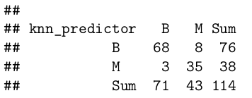
KNN Model
Error | 0.09649123
Specificity | 0.8139535
Sensitivity | 0.9577465
Precision | 0.8947368

Slide 25
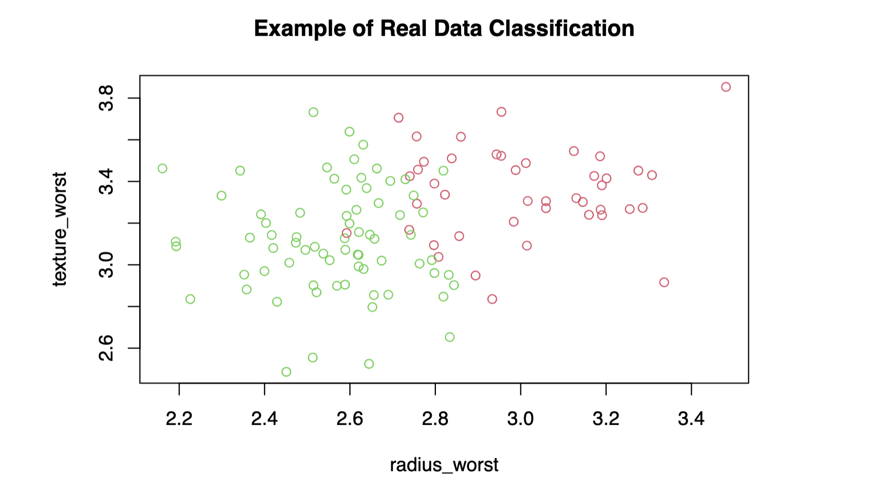
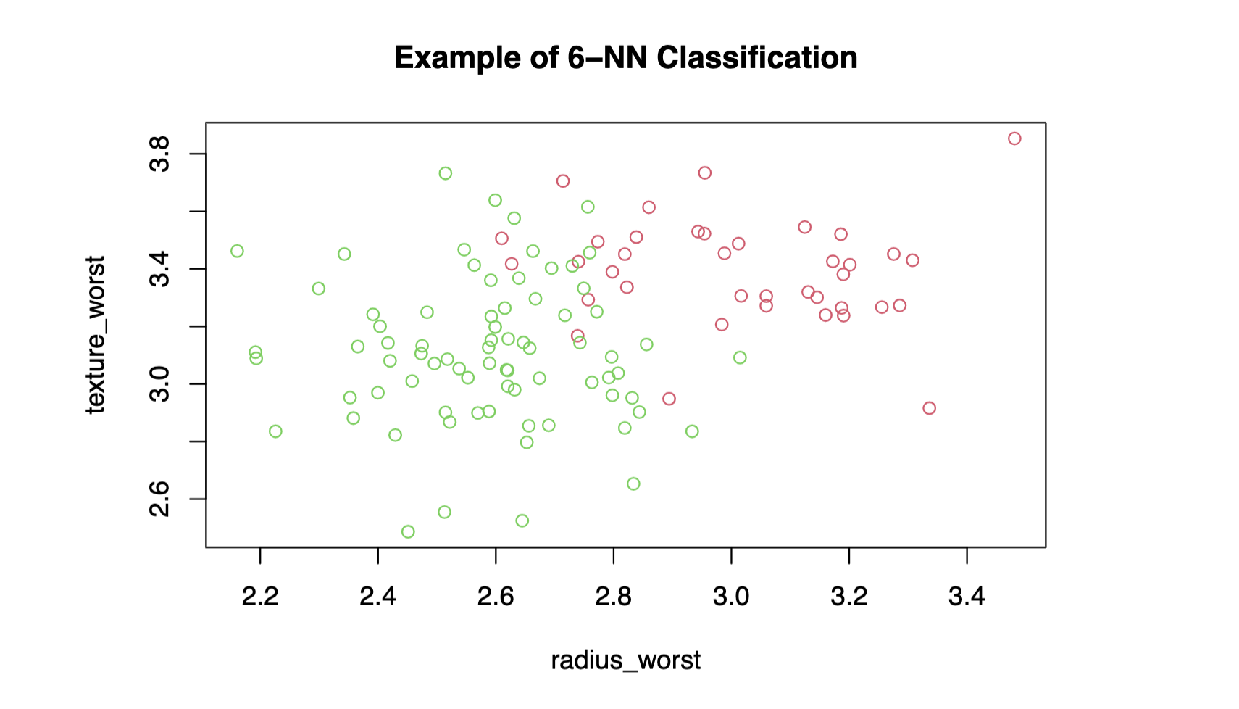
Before and After applying KNN

Slide 26
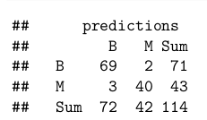
Bayes Classifier
Error | 0.06140351
Specificity | 0.952381
Sensitivity | 0.9583333
Precision | 0.971831

Slide 27
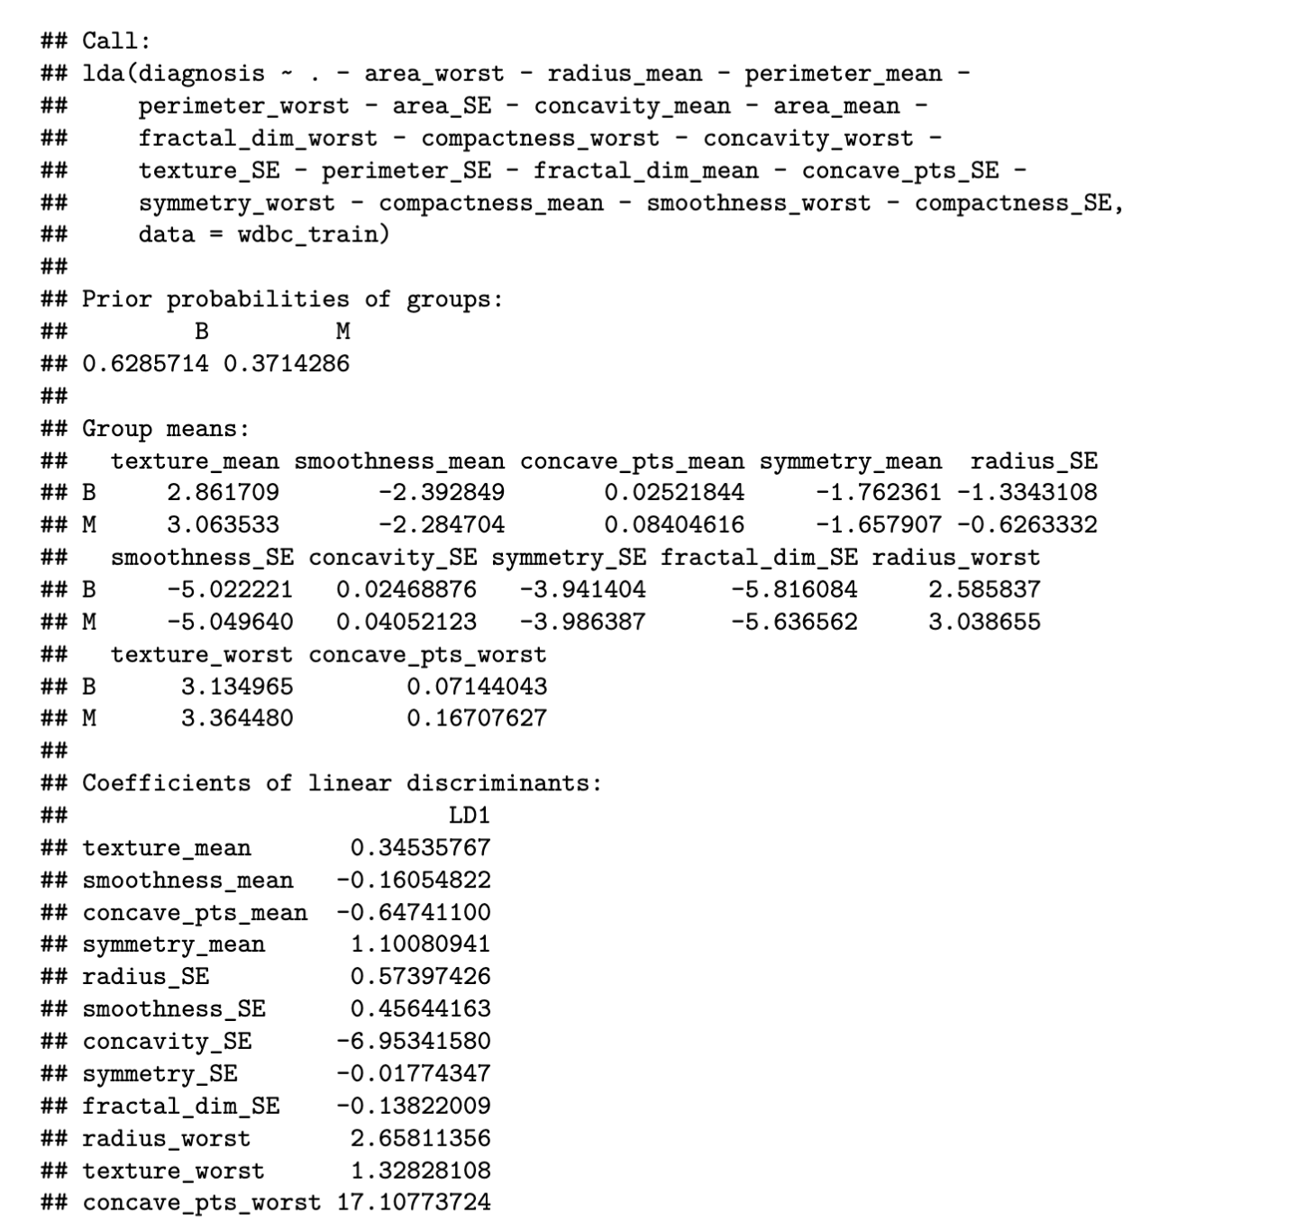
Linear Discriminant Analysis

Slide 28
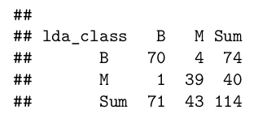
Linear Discriminant Analysis
Error | 0.04385965
Specificity | 0.9069767
Sensitivity | 0.9859155
Precision | 0.9459459

Slide 29
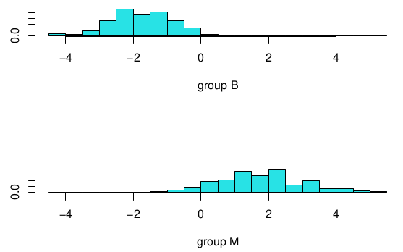
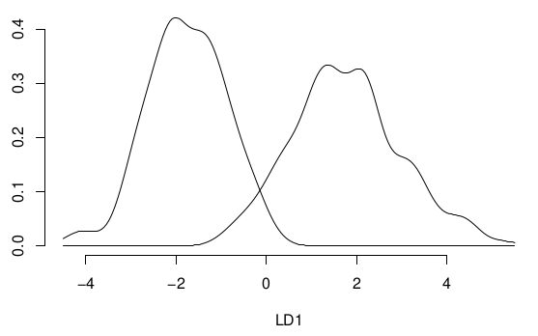
Linear Discriminant Analysis

Slide 30
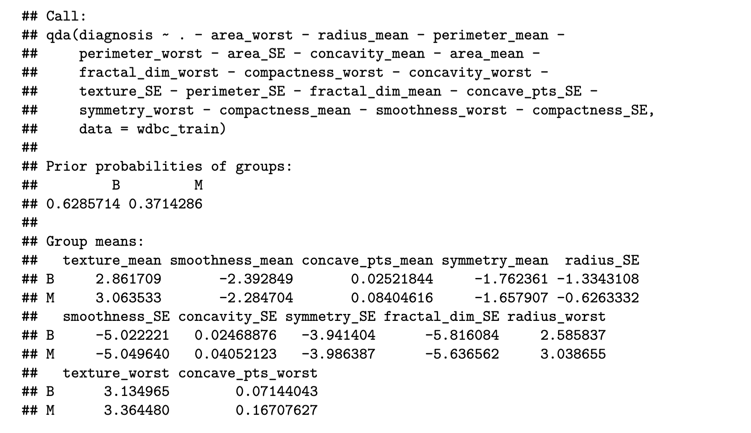
Quadratic Discriminant Analysis

Slide 31
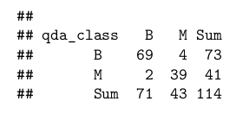
Quadratic Discriminant Analysis
Error | 0.05263158
Specificity | 0.9069767
Sensitivity | 0.971831
Precision | 0.9452055

Slide 32
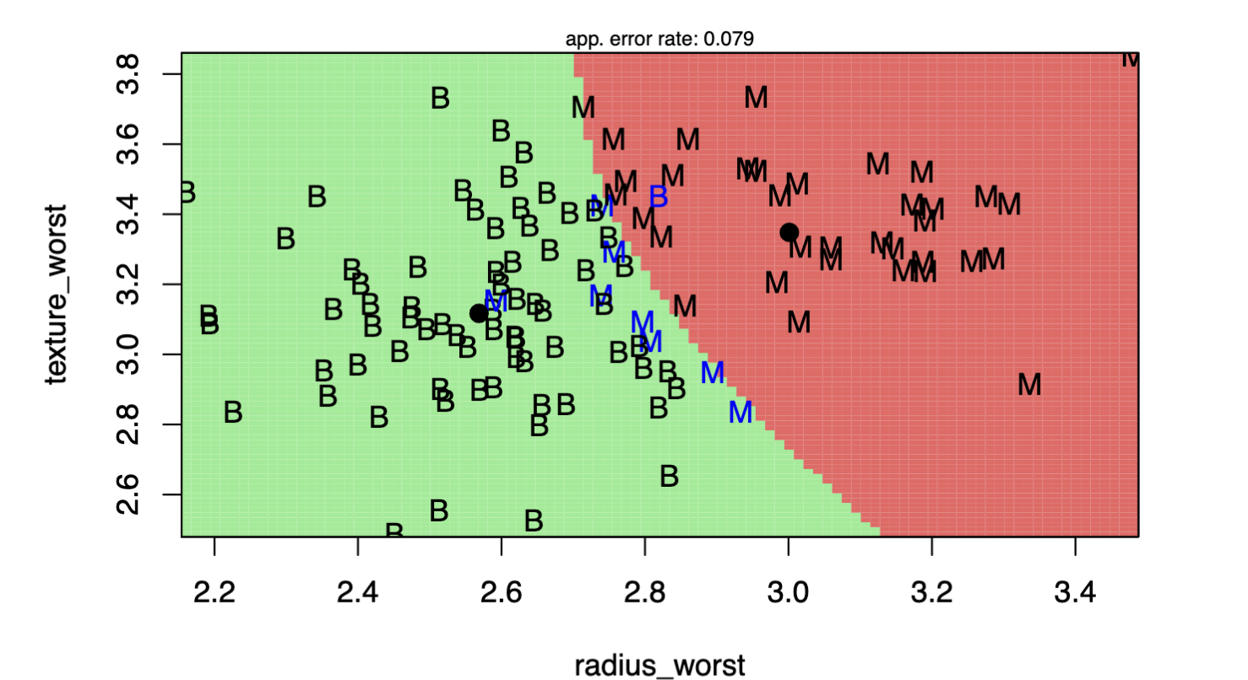
QDA plot

Slide 33
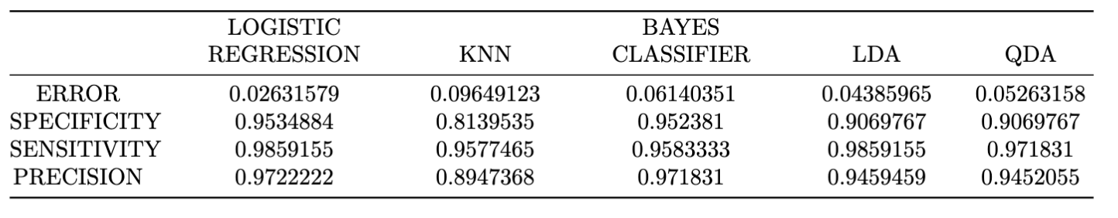
Final Considerations

